Slide 1
Academic Honours Program 2026

Slide 2
Acknowledgement of Country
We want to begin today by acknowledging the Turrbal and Jagera people as the Traditional Custodians of Meanjin, the lands in which our school is located, and where we meet, work and learn. We recognise their cultures, histories, and diversity, and their deep connection to the lands, waters, and seas of Queensland. We pay our respects to their Elders, past, present and emerging, and extend our respect to Aboriginal and Torres Strait Islander peoples here today.

Slide 3
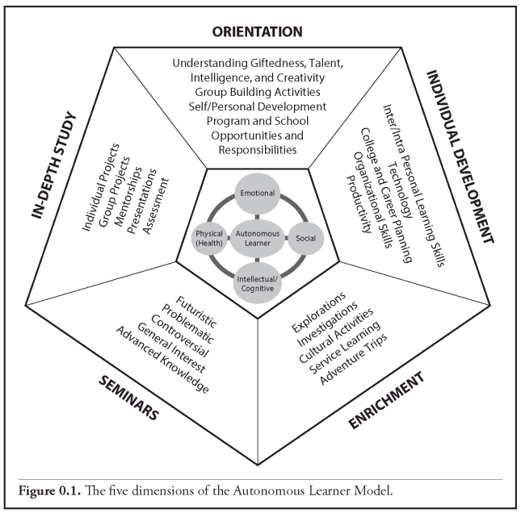
Autonomous Learner Model
Developed by George T. Betts and has been evolving as a model for enrichment and extension over the years.
First gifted and talented model that focuses on the whole child.
Most approaches are developed for teachers to deliver curriculum “to” learners rather than “with” the students.
Students are high performing 24/7 and need a complete approach to learning and living not only in the school setting, but at home and in the community.
“Autonomous learners perceive learning and living as two main components of their ongoing development of potential in the cognitive, emotional, social, and physical domains. Their motivation comes from within, they internalise skills, and passion learning is their driving force. Autonomous learners are never satisfied, for they perceive their needs for a nourishing life, as well as the greater needs of society.” – George T. Betts
Reference: (Betts, G. T., Carey R. J., & Kapushion, B. M. (2021). Autonomous Learner Model Resource Book. Routledge.

Slide 4
VISION
To enrich high performing students using the Autonomous Learner Model, drive their passion for learning and maintain their wellbeing at school.

Slide 5
A History…
-2020
Streamed classes of Academic Honours students
2021-2024
Shift from Academic Honours to Leadership Honours. Students had a mentor with coaching across the year.
2025 – onwards
Pilot program for Academic Honours students based on the Autonomous Learner Model

Slide 6
Structure
First Year | Second Year | Third Year
Orientation Individual Development Enrichment Seminar | Orientation Individual Development Enrichment In-Depth Study | Orientation Enrichment In-Depth Study
2-3 Outside of School Sessions per Term + 1x incursion each year (Learning Retreat)

Slide 7
What happens in the afternoon sessions?
Meeting conference style sessions with an agenda of what is completed each session. Eventually, students will lead and run the sessions as they become autonomous learners (under the supervision of Pathways & Performance).
Collaborate with like-minded peers and engage in intellectual debates, activities, and investigations according to the Autonomous Learner model.
Visits from mentors and experts in their fields.
Collaborate with P&P staff to develop a Personalised Learning Record that curriculum teachers will use to differentiate for Honours students within the classroom.

Slide 8
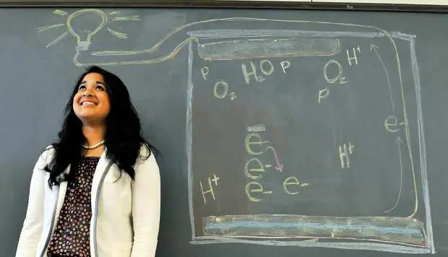
Looks Like | Sounds Like | Feels Like
Students working with like-minded peers Conference Activity based | Student led Academic conversations Questioning, thinking critically | Enriching Community Interesting (developing your own talents) Creative
As a high school student at Union Colony High School in Greeley, Colorado
Nurul ModhdReza became interested in sustaining and preserving the world’s energy needs through the use of bacteria. She developed a prototype of a specialized, single-celled microbial fuel cell. This electrochemical device produces electricity through the clarification of wastewater and assists in the evolution of biotechnology to develop a greater understanding of bacterial power production. This device will sustain the energy requirement of wastewater treatment plants all over the world. Nurul’s discovery will provide energy solutions in some of the most difficult regions of our world. At the inception of her work, she did not understand the full impact of the research until she was approached by water treatment companies. This spurred her to continue with the project. Nurul illustrates the importance of exploration and investigation within the ALM. Her project is now a long-term In-Depth Study that will continue to evolve throughout her college career.
Reference: Betts, G., Kapushion, B., & Carey R. J. (2016). The Autonomous Learner Model: Supporting the Development of Problem Finders, Creative Problem Solvers, and Producers of Knowledge to Successfully Navigate the 21st Century.

Slide 9
At School
TGSHS believes in inclusive classrooms that allows all students to flourish through the differentiation of curriculum for students. Personalised Learning Records are designed to support teachers in enriching and extending students in their specific curriculum area. If you are concerned about extension within the classroom setting, please be in contact with the curriculum teacher.
When students are in their Seminar or In-Depth study phase, students are encouraged to continue working on this project in the classroom when they have demonstrated mastery of the curriculum in consultation with their curriculum teacher.
One ‘Learning Retreat’ (school incursion) where students are engaged in stimulating project based work facilitated by an external organisation, and coordinated by P&P.
Inclusion of ALM in regular classroom, whole school, family and community, special experiences are needed to meet the learners’ needs (Betts, Carey, & Kapushion, 2014).

Slide 10
Application
Apply via the School Website: Curriculum/Excellence programs/Academic Honours by Thursday 15 May
Year 5 Semester 2 Report Card/Year 6 Semester 1 Report Card
Year 5 NAPLAN results
Student response for why they want to be enrolled in the program, and what they hope to achieve.
Letter of reference from their teacher
Complete entry exam: GSAM (Gifted Student Ability Measure) 29 May 2025
Receive acceptance or decline letters from the school regarding student enrolment in the program. (Your student may be offered German Immersion too) 20 June 2025

Slide 11
Takeaways
‘Don’t fret!’ she said. ‘You’ve learned the things you need to pass that test and many more – I’m certain you’ll succeed. We’ve taught you that the Earth is round, that red and white make pink, and something else that matters more – We’ve taught you how to think’ (p. 26).
- Dr Seuss Hooray for Diffendoofer Day!
Notes:
Some people have the ability to create excitement in their lives.
They are the ones who strive, who grow, who give and share.
They are the ones who love.
They possess passion… for themselves, others, nature and experiences.
They have the ability to see beyond today, to rise above the hectic pace, to strive for their own perfection…
And they are gentle, for they love themselves, and they love others…
Through their living, they create peace and contentment .
At the same time, they create excitement for there is always another mountain, a deeper joy, a new dawn…
- Betts

